Slide 1
Vehicle detection and counting system
--- Cyril Souza – 20BAI10199
-- Aditya Upadhyay – 20bai10086

Slide 2
Overview Of Our Project
Introduction to VDC system.
Scope of VDC program.
Tools that are used in making VDC system.
How VDC works.
Our Program code that we use for VDC system.
References
Thank You/Outroduction

Slide 3
Introduction
Vehicle detection and vehicle type recognition is a practical application of computer vision and machine learning concepts and is directly applicable for various operations in a traffic surveillance system contributing to an intelligent traffic surveillance system.
This will introduce the processing of automatic vehicle detection and recognition using static image datasets. Further using the same technique, we shall improvise vehicle detection by using live CCTV surveillance. The surveillance system includes detection of moving vehicles and recognizing them, counting number of vehicles.

Slide 4
Scope of our program
Helps traffic police: A vehicle detection and counting system could be beneficial for the traffic police because everything they can monitor from one place only likes how many vehicles have crossed this toll and which vehicle.
Maintaining records: It is challenging for some individuals to record all the vehicles with them because the cars are passing by in real-time. It’s not like that one is watching the video, and they can pause it and have a note of it, so to remove this limitation, this application can be very well-versed to attain the time-saving quality and be automated.
Traffic surveillance control: As this application can be planted anywhere as it only requires a camera or some wires (for establishing the connectivity with the central system) hence if the traffic is high at someplace, then from that area, an officer can monitor it and forward the information to next toll officer so that they could be prepared beforehand.

Slide 5
Tools of our program
Libraries to import
PIL
OpenCV
Numpy
Requests

Slide 6
Working of our Code
We will fetch the image from the internet that we will be working on. We will then resize the image and convert it into a NumPy array.
To get better output, we will perform some transformations on the image. Here we will convert the image into grayscale.
Next, we will apply Gaussian Blur to remove the noise from the image. Gaussian blur is one of the techniques of image processing. It is widely used in graphics designing too for reducing the noise and smoothing the image so that for further preprocessing, it will generate better output. Along with reducing the noise in the image Gaussian blur technique also reduces the image’s details. Here for applying this preprocessing technique, we will be using the Gaussian Blur function().
Dilation is one of the morphological techniques where we try to fill the pixels with the element, also known as kernels (structured pieces), to fill the missing parts of the images whenever needed

Slide 7
Working of our Code(after dilation)
Now we will perform a Morphology transformation with the kernel. Here we are using a morphology-Ex technique that tells the function on which image processing operations need to be done. The second argument is about what operations must be done, and you may need elliptical/circular shaped kernels. To implement the morphology-Ex method using OpenCV we will be using the get structuring element method.
Now we need a car cascade to detect cars. So, we first need to upload them to collab (if you are doing it in the collab, if you are doing it in the local machine, then add the cascade files in the same folder) and specify the path car_cascade_src. Here we will use the Cascade Classifier function, the predefined function of OpenCV, to train the images from the pre-trained XML file (Cascade file – car). We need to detect multiple objects, i.e. cars, to use detect MultiScale.
We will use the above-returned contours and draw a rectangle around detected cars. Here we will see that it will create the rectangle with a red boundary around every car it detects.

Slide 8
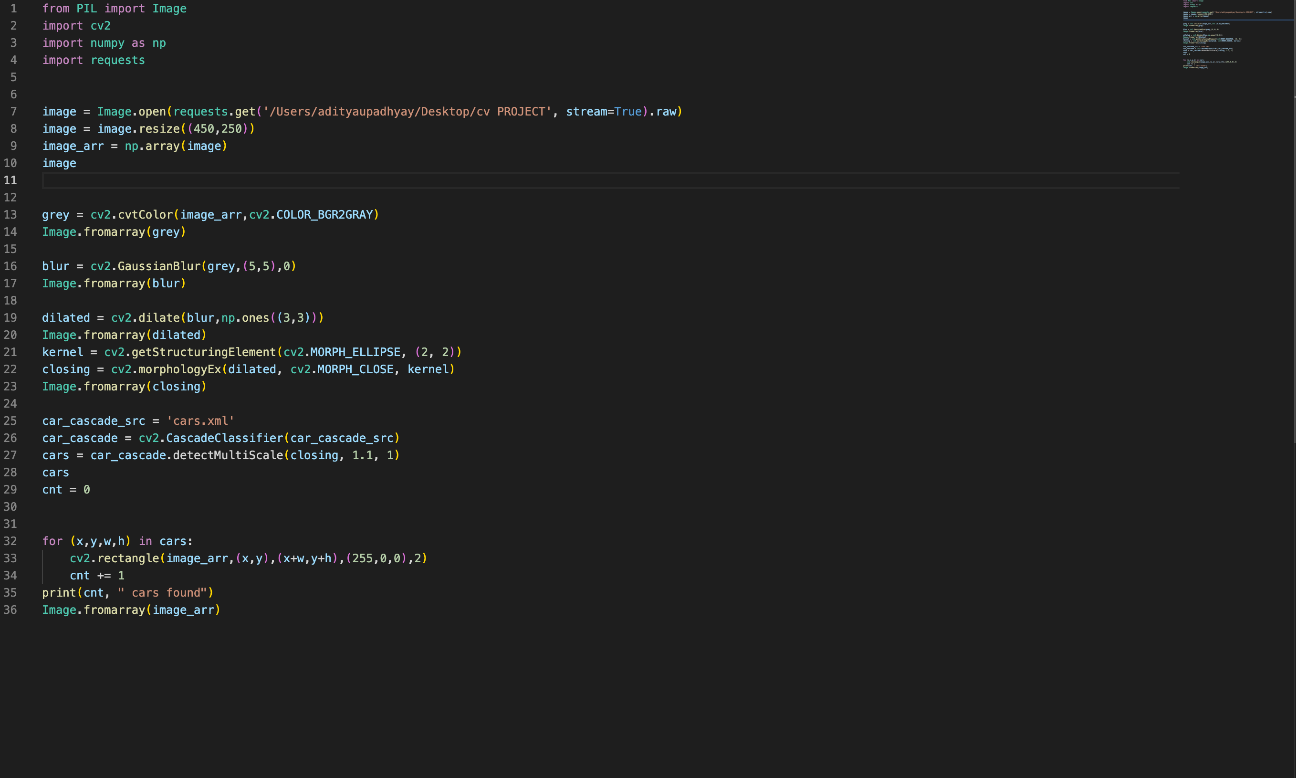
Code

Slide 9
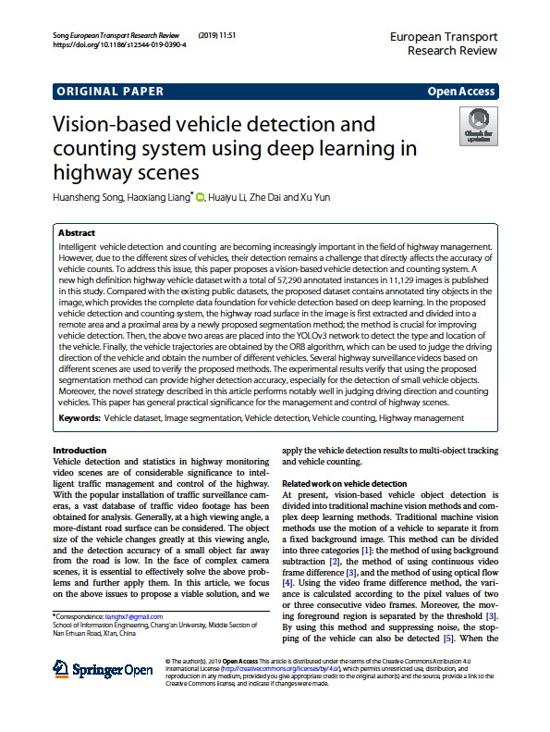

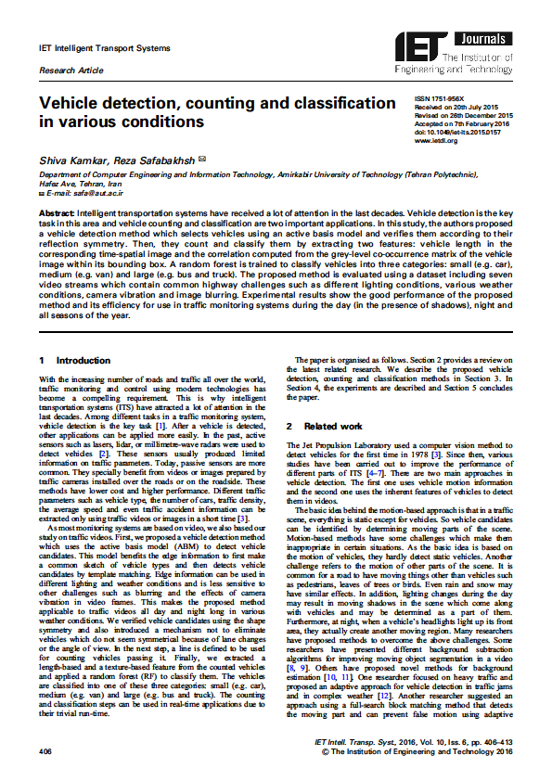
References

Slide 10
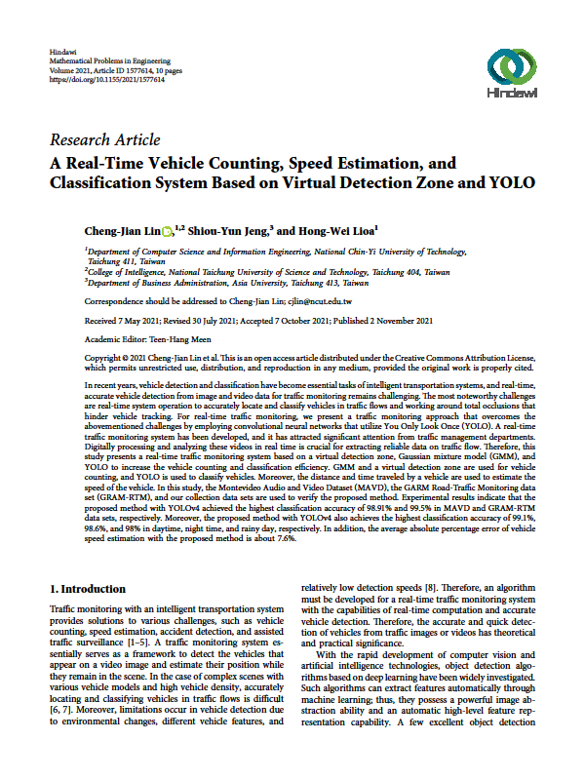
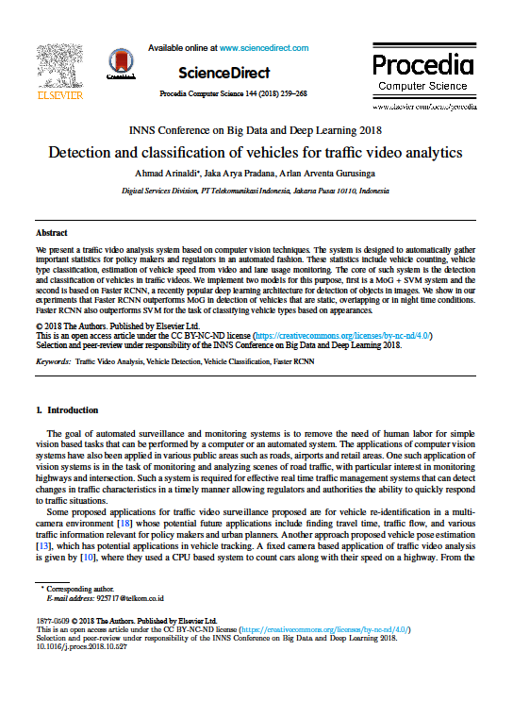
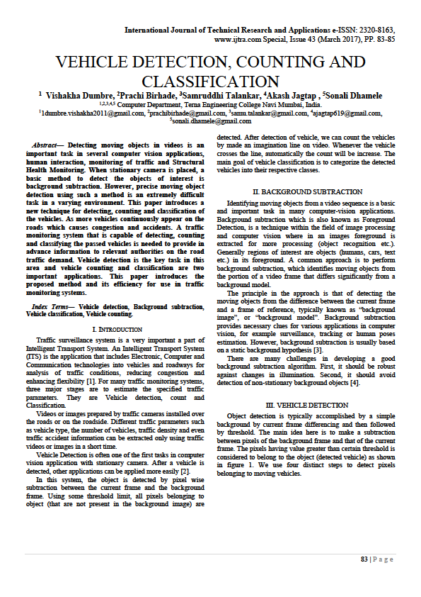
References

Slide 11
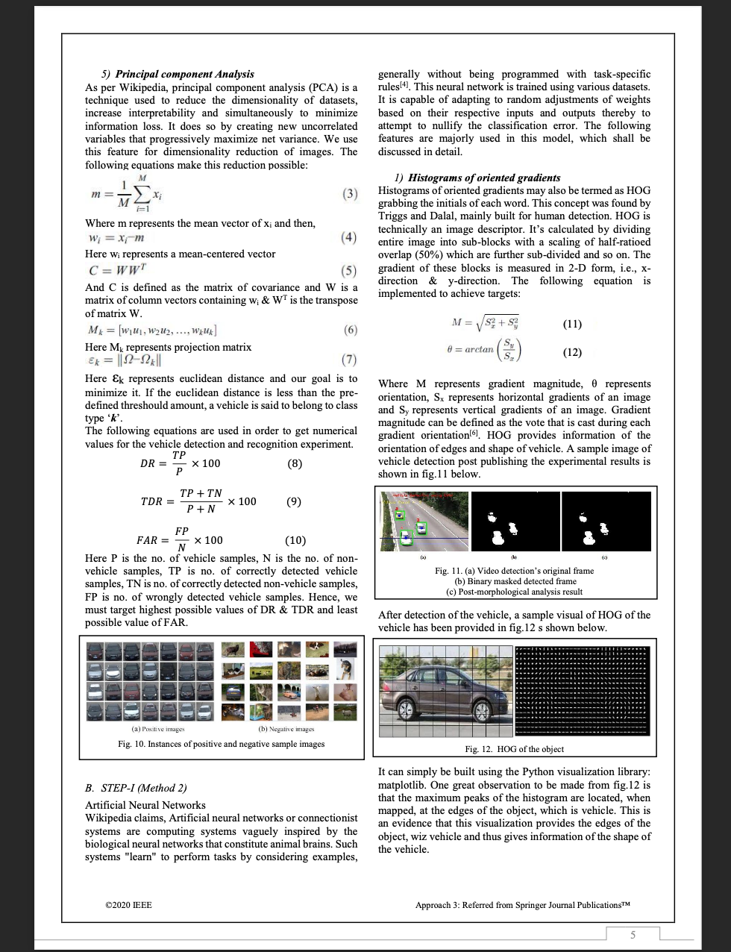
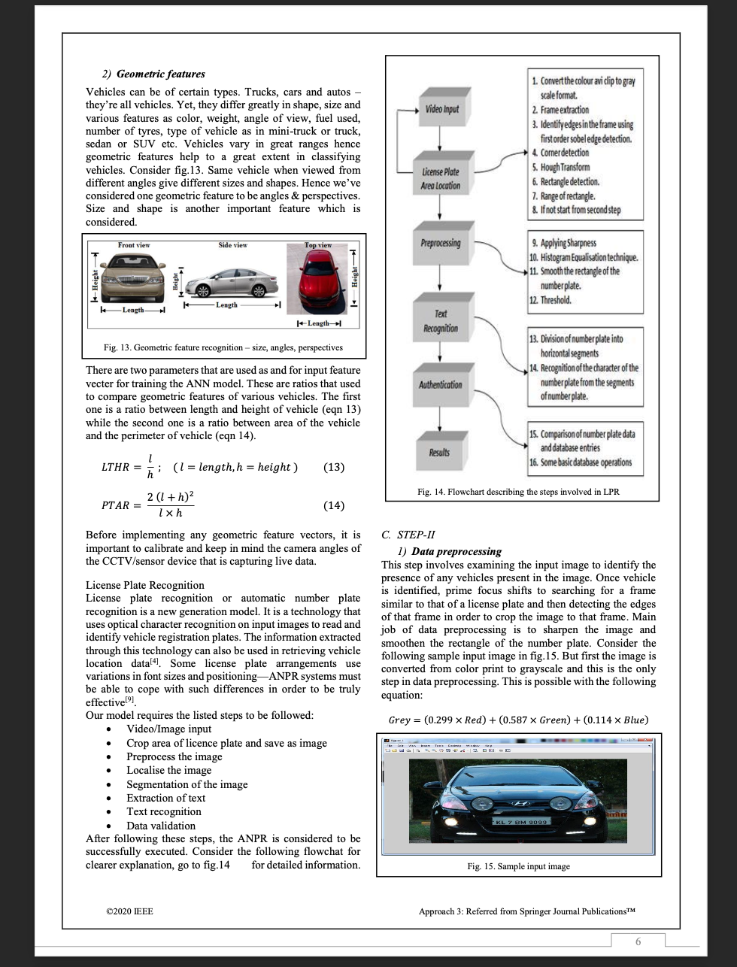
References

Slide 12
Conclusion
The many benefit of this project would be reduced manual efforts in manual checking of each vehicle and also in maintaining manual records of the same.

